Slide 1
Subject: Programming in Python
Part-1
CSE1-4th Sem
Neha Chadha
CSE Department

Slide 2
Introduction to Programming with Python

Slide 3
Introduction to Python
Python is Interpreted: Python is processed at runtime by the interpreter. You do not need to compile your program before executing it. This is similar to PERL and PHP.
Python is Interactive: You can actually sit at a Python prompt and interact with the interpreter directly to write your programs.
Python is Object-Oriented: Python supports Object-Oriented style or technique of programming that encapsulates code within objects.

Slide 4
Python is a Beginner's Language: Python is a great language for the beginner-level programmers and supports the development of a wide range of applications from simple text processing to WWW browsers to games.
Python is used for software development at companies and organizations such as Google, Yahoo, CERN, Industrial Light and Magic, and NASA.

Slide 5
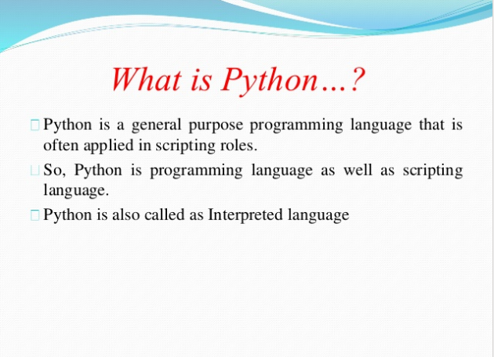

Slide 6
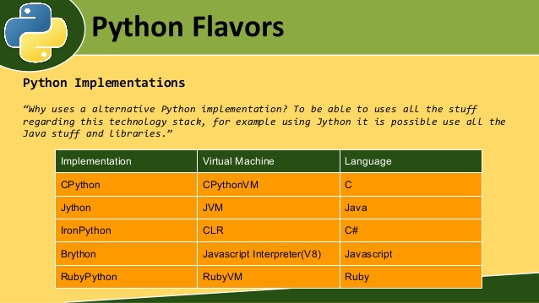

Slide 7
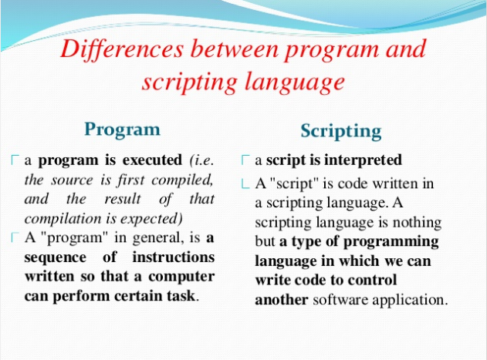

Slide 8
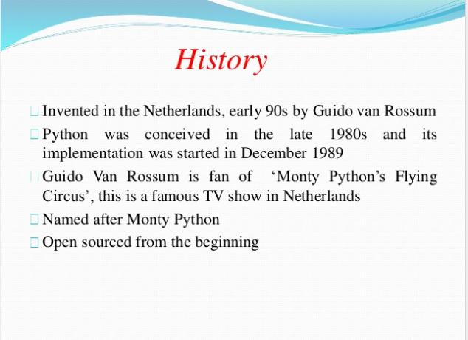

Slide 9
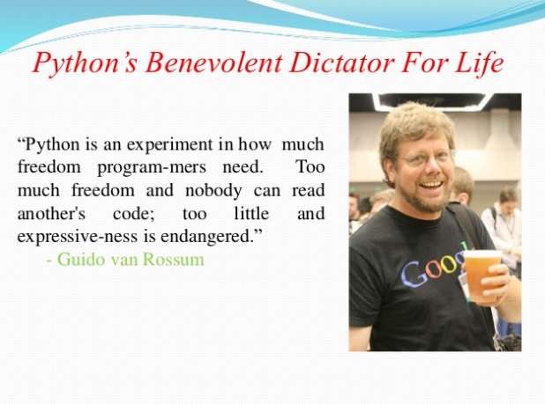

Slide 10
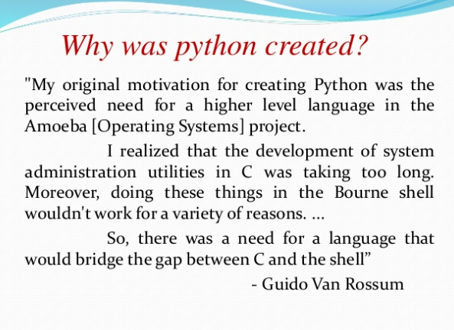

Slide 11
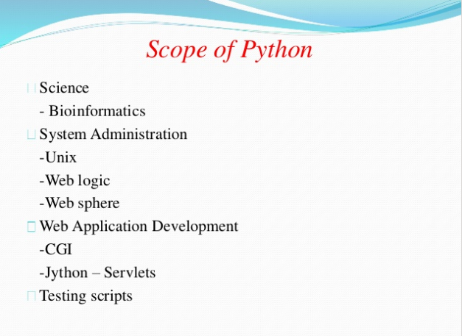

Slide 12
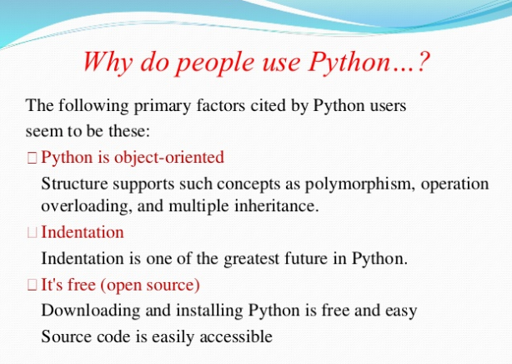

Slide 13
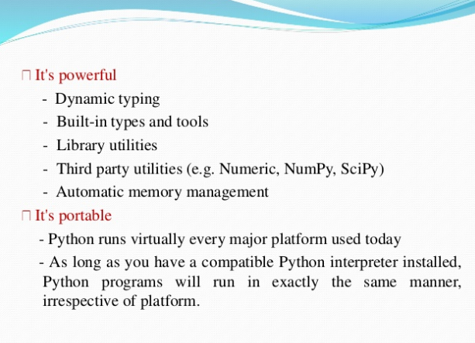

Slide 14
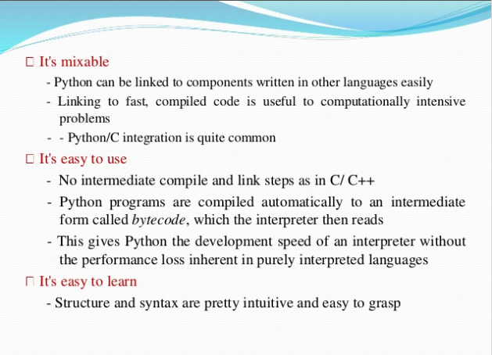

Slide 15




Compiling and interpreting
Many languages require you to compile (translate) your program into a form that the machine understands.
Python is instead directly interpreted into machine instructions.
compile
execute
source code
Hello.java
byte code
Hello.class
output
interpret
source code
Hello.py
output

Slide 16
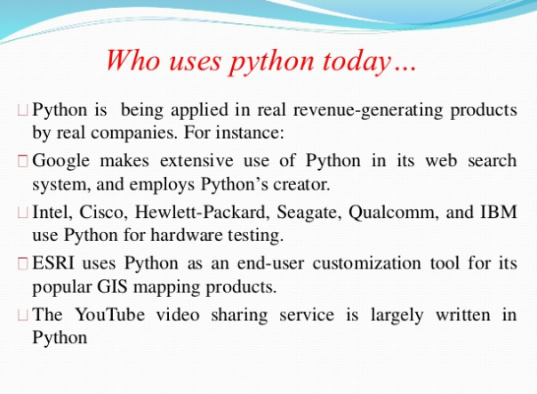

Slide 17
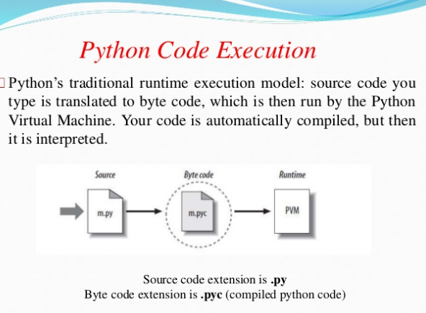

Slide 18
Advantages/Benefits of Python
The diverse application of the Python language is a result of the combination of features which give this language an edge over others. Some of the benefits of programming in Python include:
1. Presence of Third Party Modules:
The Python Package Index (PyPI) contains numerous third-party modules that make Python capable of interacting with most of the other languages and platforms.
2. Extensive Support Libraries:
Python provides a large standard library which includes areas like internet protocols, string operations, web services tools and operating system interfaces. Many high use programming tasks have already been scripted into the standard library which reduces length of code to be written significantly.

Slide 19
3. Open Source and Community Development:
Python language is developed under an OSI-approved open source license, which makes it free to use and distribute, including for commercial purposes.
4. Learning Ease and Support Available:
Python offers excellent readability and simple-to-learn syntax which helps beginners to utilize this programming language.
Additionally, the wide base of users and active developers has resulted in a rich internet resource bank to encourage development and the continued adoption of the language.

Slide 20
5. User-friendly Data Structures:
Python has built-in list and dictionary data structures which can be used to construct fast runtime data structures.
Further, Python also provides the option of dynamic high-level data typing which reduces the length of support code that is needed.
6. Productivity and Speed:
Python has object-oriented design, provides enhanced process control capabilities, and possesses strong integration and text processing capabilities and its own unit testing framework, all of which contribute to the increase in its speed and productivity. Python is considered a viable option for building complex multi-protocol network applications.

Slide 21
Setting Up the Python Development Environment
Open a terminal window and type "python" to find out if it is already installed and which version is installed.

Slide 22
Unix and Linux Installation
Open a Web browser and go to https://www.python.org/downloads/.
Follow the link to download zipped source code available for Unix/Linux.
Download and extract files.
Editing the Modules/Setup file if you want to customize some options.
run ./configure script
make install

Slide 23
Window Installer
Open a Web browser and go to https://www.python.org/downloads/.
Follow the link for the Windows installer python-XYZ.msi file where XYZ is the version you need to install.
Save the installer file to your local machine and then run it to find out if your machine supports MSI.
Run the downloaded file.

Slide 24
Python as a Calculator
+
-
*
/
%
**
//

Slide 25
Basic Syntax
Python Identifiers
A Python identifier is a name used to identify a variable, function, class, module or other object. An identifier starts with a letter A to Z or a to z or an underscore (_) followed by zero or more letters, underscores and digits (0 to 9).
Python does not allow punctuation characters such as @, $, and % within identifiers. Python is a case sensitive programming language. Thus, Manpower and manpower are two different identifiers in Python.

Slide 26
Reserved Words
The following list shows the Python keywords.
and | exec | not
assert | finally | or
break | for | pass
class | from | print
continue | global | raise
def | if | return
del | import | try
elif | in | while
and | exec | Not
else | is | with
except | lambda | yield
else | is | with

Slide 27
Lines and Indentation
Python provides no braces to indicate blocks of code for class and function definitions or flow control. Blocks of code are denoted by line indentation

Slide 28
Multi-Line Statements
Statements in Python typically end with a new line. Python does, however, allow the use of the line continuation character (\) to denote that the line should continue.

Slide 29
Quotation in Python
Python accepts single ('), double (") quotes to denote string literals, as long as the same type of quote starts and ends the string.

Slide 30
Comments in Python
A hash sign (#) that is not inside a string literal begins a comment.

Slide 31
Multiple Statement Groups as Suites
A group of individual statements, which make a single code block are called suites in Python.
if expression :
suite
elif expression :
suite
else :
suite

Slide 32
Assigning Values to Variables
The equal sign (=) is used to assign values to variables.
Multiple Assignment
a=b=c=1
a,b,c=1,2.3, “Hello”

Slide 33
Data Types
Numbers
String
List
Tuple
Dictionary

Slide 34
Number
Number data types store numeric values.
Python supports four different numerical types −
int (signed integers)
long (long integers, they can also be represented in octal and hexadecimal)
float (floating point real values)
complex (complex numbers)

Slide 35
Strings
Strings in Python are identified as a contiguous set of characters represented in the quotation marks.
Python allows for either pairs of single or double quotes. Subsets of strings can be taken using the slice operator ([ ] and [:] ) with indexes starting at 0 in the beginning of the string
The plus (+) sign is the string concatenation operator and the asterisk (*) is the repetition operator.

Slide 36
Lists
A list contains items separated by commas and enclosed within square brackets ([]). To some extent, lists are similar to arrays in C. One difference between them is that all the items belonging to a list can be of different data type.
The values stored in a list can be accessed using the slice operator ([ ] and [:]) with indexes starting at 0 in the beginning of the list.
The plus (+) sign is the list concatenation operator, and the asterisk (*) is the repetition operator.

Slide 37
Tuple
A tuple is another sequence data type that is similar to the list.
A tuple consists of a number of values separated by commas. Unlike lists, however, tuples are enclosed within parentheses().

Slide 38
The main differences between lists and tuples are:
Lists are enclosed in brackets ( [ ] ) and their elements and size can be changed, while tuples are enclosed in parentheses ( ( ) )
Tuples cannot be updated. Tuples can be thought of as read-only lists. List can be updated.

Slide 39
Dictionary
Python's dictionaries are kind of hash table type.
They consist of key-value pairs.
A dictionary key can be numbers or strings.
Dictionaries are enclosed by curly braces ({ }) and values can be assigned and accessed using square braces ([]).

Slide 40
Random number
Using the random module, we can generate pseudo-random numbers.
The function random() generates a random number between zero and one [0, 0.1 .. 1].
Numbers generated with this module are not truly random but they are enough random for most purposes.
Eg1: import random
random.randinnt(1,10)
Eg2:import random
a=[1,2,3,4]
b=random.choice(a)
print(b)

Slide 41
Real number
All numbers are real numbers in python
But not a complex number only real part belongs to real number
Eg:
a= 2+3j
a.real
output: 2.0

Slide 42
Immutable variables
Variables whose value remain fixed once it is declared.
Tuples contain immutable variables. It cannot be updated.

Slide 43
Input Statement
input(“Enter name”)
int(input(“Enter value”)
float(input(“Enter value”)
eval(input(“Enter value”)

Slide 44
print statement
print(a)
print(“result is”,a)
print(a);print(b)
print(a,b)

Slide 45
Types of Operator
Python language supports the following types of operators.
Arithmetic Operators
Comparison (Relational) Operators
Assignment Operators
Logical Operators
Bitwise Operators
Membership Operators

Slide 46
Arithmetic Operators
+
-
*
/
%
**
//

Slide 47
Comparison Operators
==
!=
<
>
<=
>=

Slide 48
Assignment Operators
=
+=
-=
*=
/=
%=
**=
//=

Slide 49
Bitwise Operators
&(and)
|(or)
^(XOR)
~(1s complement)
{The result obtained –x-1}
<<(binary left shift)
{The result obtained x*2^{y}}
>>(binary right shift)
` {The result obtained x/2^{y}}

Slide 50
Logical Operators
and
Eg: (10<15) and (6<4)
False
or
not

Slide 51
Membership Operators
in
Eg :
a=(1,2,3,4)
4 in a
True
a=(1,2,3,4)
5 in a
False
not in

Slide 52
Identity Operators
is
Eg: a=10
b=15
a is b
False
is not

Slide 53
Control Statements
If
If- else
Nested if-else
Multiway if elif else
Break
Continue

Slide 54
If,If…else,nested statements
Sr.No. | Statement & Description
1 | if statements An if statement consists of expression followed by one or more statements.
2 | if...else statements An if statement can be followed by an optional else statement, which executes when the expression is FALSE.
3 | nested if else statement . You can multiple if and single else statement
4 | Mutiway else if statements You can if elif and single else statement

Slide 55
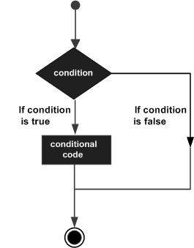
If statement

Slide 56
Syntax of if statement
if(expression):
suite
Eg:
a=10
if(a<100):
print(“You win”)
print(“You lost”)

Slide 57
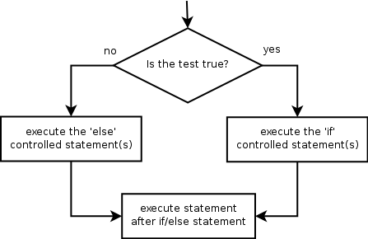
If else

Slide 58
Syntax of if else statement
if(expression):
suite
else:
suite

Slide 59
Nested if statement else
if expression :
suite
if expression :
suite
else :
suite

Slide 60

Multiway elseif
if expression :
suite
elif expression :
suite
else :
suite

Slide 61
WAP to check character entered is vowel or consonant
char=input()
if ord(char)>=65 and ord(char)<=90:
print("upper case")
if char in['A','E','I','O','U']:
print("vowel")
else:
print("consonant")

Slide 62
loops
Sr.No. | Loop Type & Description
1 | while A while loop statement in Python programming language repeatedly executes a target statement as long as a given condition is true.
2 | for loop Executes a sequence of statements multiple times and abbreviates the code that manages the loop variable.
3 | nested loops You can use one or more loop inside any another while, for or do..while loop.

Slide 63
while
Syntax:
while expression:
statement(s)
Eg:
a=1
while a<=10:
print (a)
a+=1

Slide 64
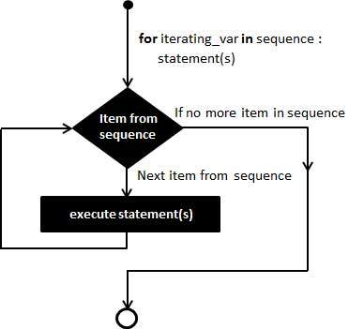
for
Syntax
for iterating_var in sequence:
statements(s)
Eg:
for i in range(1,11):
print(i)
i+=1

Slide 65
range
range(1,10)
Eg: a=range(1,10)
for i in a
print(a)
range(0,20,2)
range(20,0,-2)
range(10){by default it start from 0)

Slide 66
Using else Statement with Loops
Python supports to have an else statement associated with a loop statement
If the else statement is used with a for loop, the else statement is executed when the loop has exhausted iterating the list.
If the else statement is used with a while loop, the else statement is executed when the condition becomes false.

Slide 67
while with else
a=10
while a<5:
print(a)
a+=1
else:
print("value is greater")

Slide 68
for with else
for i in range(1,11):
print(i)
i+=1
else:
print(“hello")

Slide 69
Factorial of number
f=1
n=int(input("n"))
for i in range(1,n+1):
f*=i
print(f)

Slide 70
Factorial of number by decrementing loop
f=1
for i in range(5,1,-1):
f=f*i
print(f)

Slide 71
WAP to count number of vowel and consonants in string
v=0
c=0
n=input("name")
for letter in n:
if(letter in ['a','e','i','o','u']):
v=v+1
print("v",v)
else:
c=c+1
print("c",c)

Slide 72
Break,continue,pass
Sr.No. | Control Statement & Description
1 | break statement Terminates the loop statement and transfers execution to the statement immediately following the loop.
2 | continue statement Causes the loop to skip the remainder of its body and immediately retest its condition prior to reiterating.
3 | pass statement The pass statement in Python is used when a statement is required syntactically but you do not want any command or code to execute.

Slide 73
break
It terminates the current loop and resumes execution at the next statement, just like the traditional break statement in C.
The most common use for break is when some external condition is triggered requiring a hasty exit from a loop. The break statement can be used in both while and for loops.
If you are using nested loops, the break statement stops the execution of the innermost loop and start executing the next line of code after the block.

Slide 74
Break example
Eg:for i in range(10):
if i==7:
break
print(i)

Slide 75
WAP in Python to print the output c,o,m from the word “computer” by using break statement.
a=“computer"
for letter in a:
if letter==“p":
break
print(letter)

Slide 76
Continue
It returns the control to the beginning of the while loop.. The continuestatement rejects all the remaining statements in the current iteration of the loop and moves the control back to the top of the loop.
The continue statement can be used in both while and for loops.
Eg: for i in range(10):
if i==7:
continue
break
print(i)

Slide 77
pass
It is used when a statement is required syntactically but you do not want any command or code to execute.
The pass statement is a null operation; nothing happens when it executes. The pass is also useful in places where your code will eventually go, but has not been written yet
Eg: for i in range(10):
if i==7:
pass
print("take pass")
print(i)

Slide 78
WAP to calculate the length of a string and convert the given lowercase string into uppercase if length of string is greater and equal to 10, the other case is to convert into lowercase
s=input("Enter string")
if len(s)<=10:
s1=s.upper()
else:
s1=s.lower()
print(s1)

Slide 79
WAP to add 'ing' at the end of a given string (length should be at least 3). If the given string already ends with 'ing' then add 'ly'. If the string length of the given string is less than 3, leave it unchange
word = input("Please input a word")
print(len(word))
if len(word) >= 3:
word = word+"ing"
if word[-3:] == "ing":
word = word+ "ly"
else:
print("word")
print ("The new word is:", word)

Slide 80
WAP to accept sales from the user and calculate the commission accordingly.
Sales | Commission
>=30001 | 15%
22001-30000 | 10%
12001-22000 | 7%
5001-12001 | 5%
0-5000 | 0%

Slide 81
WAP that prints all the numbers from 0 to 6 except 3 and 6.
for x in range(6):
if (x == 3 or x==6):
continue
print(x,end=' ')
print("\n")

Slide 82
WAP which iterates the integers from 1 to 10. For multiples of three print "Acet" instead of the number and for the multiples of five print "College". For numbers which are multiples of both three and five print "ACETCollege".
for a in range(10):
if a % 3 == 0 and a % 5 == 0:
print("ACETCollege")
continue
elif a % 3 == 0:
print("ACET")
continue
elif a % 5 == 0:
print("College")
continue
print(a)

Slide 83
WAP to print following patterns
*
* *
* * *
* * * *..n rows
n=eval(input("enter"))
for i in range(1,n+1):
for j in range(1,i+1):
print(“*” ,end="")
print(" ")

Slide 84
*
* *
* * *
* *
*
n=eval(input("enter"))
for i in range(n):
for j in range(i):
print ('* ', end="")
print('')
for i in range(n,0,-1):
for j in range(i):
print('* ', end="")
print('')

